Slide 1

Introduction to Software Testing
Special Chapter
Fuzz Testing / Fuzzer / Fuzzing
Farn Wang
Dept. of EE, National Taiwan Univ.

Slide 2


Fuzzing / Fuzzer / Fuzz Testing
Run program on many random, abnormal inputs and look for bad behavior in the responses
  Bad behaviors such as crashes or hangs
A stormy heavy-rain night in 1988
Connected to office Unix system
via a dial up connection
Crashed many UNIX utilities
  Professor Barton P. Miller
  Univ. of Wisconsin
https://pages.cs.wisc.edu/~bart/fuzz/
Introduction to Software Testing (Ch 4)
© Ammann & Offutt

Slide 3
Fuzzing / Fuzzer / Fuzz Testing
Felt something deeper
Coined the term
Fuzz testing
Black-box approach
Asked three groups in his grad-seminar course to implement this idea
Two groups failed to achieve any crash results!
The third group succeeded! Crashed 25-33% of the utility programs on the seven Unix variants that they tested
  Professor Barton P. Miller
  Univ. of Wisconsin
https://pages.cs.wisc.edu/~bart/fuzz/
Introduction to Software Testing (Ch 4)
© Ammann & Offutt

Slide 4
Fuzzing / Fuzzer / Fuzz Testing
A negative testing – finding errors
  Fault injector
  Errors found: not checking returns, Array indices out of bounds, not checking null pointers, …
  In comparison: positive testing – liveness analysis,
    checking good behaviors happen.
Automatic
Black-Box
  now extended to gray-box, white-box
malformed or semi-malformed test input
Introduction to Software Testing (Ch 4)
© Ammann & Offutt

Slide 5


Fuzzing / Fuzzer / Fuzz Testing
So many terms in software/security testing
Random Testing
  Usually after formal testing (according to user/test requirements)
  Find loopholes in an unbiased way.
  Does not focus on bad input.
Monkey Testing - acronym for random testing
Gorilla testing – hundreds of times on a module
Ad-hoc testing
  Unstructured testing
Fuzz Testing
  Random testing with abnormal input
Introduction to Software Testing (Ch 4)
© Ammann & Offutt

Slide 6
Fuzzer
Run lots of programs using random inputs
Identify failures of these programs
Correlate random inputs with failures
Fuzzer
Fuzzer driver
Random test case generator
Test oracle
System under Test
Introduction to Software Testing (Ch 4)
© Ammann & Offutt

Slide 7
Fuzzer Components
Random Test Case Generator
Test input
  Purely random impossible input.
    ////////, httpssss://///, …
  Forms
  TCP/IP packets
  Files with formats
  Html
Randomization
  Purely random,
  Feedback
    Mutation, generator, Coverage-based in gray-box?
Test Oracles
Crash dector
Exception handling dumps
Server response
Assertion dumps in the code
Oracles by users
3rd-party special purpose test oracle
  Valgrind for memory faults?
Introduction to Software Testing (Ch 4)
© Ammann & Offutt

Slide 8
Fuzzing Technologies
Purely random:
  Some knowledge about the test input format
  No feedback
Block based:
  Some functions to check the interface.
Feedback-based:
  Learning based on feedback loop.
Model-based or simulation-based:
  Correct behavior of the SuT (System under Test) is provided in a model or a simulator.
Introduction to Software Testing (Ch 4)
© Ammann & Offutt

Slide 9
Fuzzer
Steps in loop iteration
Identify target
Identify inputs
Generate fuzzed data
Execute fuzzed data
Monitor for exceptions
Determine exploitability
Example:
Relational database engine
SQL interface of the DBMS
…
Send SQL statements to server
Crashes, resource usage, etc?
Introduction to Software Testing (Ch 4)
© Ammann & Offutt

Slide 10
Fuzzer: Types of SuT (System under Test)
Application
  For desktop/mobile apps: the UI, the command-line options, the import/export capabilities.
  For web apps: urls, forms, user-generated content, RPC requests
Protocol fuzzing
  Sending forged packets to application.
  maybe as a proxy, modifying requests on the fly and replaying them.
File format fuzzing
  Generates multiple malformed samples, and opens them sequentially.
Introduction to Software Testing (Ch 4)
© Ammann & Offutt

Slide 11
Fuzzing
Simple examples on SMTP
mail from: sender@testhost
  This would then be sent in the following forms to see what effect they have:
mailmailmailmail from: sender@testhost
mail fromfromfromfrom: sender@testhost
mail from:::: sender@testhost
mail from: sendersendersendersender@testhost
mail from: sender@@@@testhost
mail from: sender@testhosttesthosttesthosttesthost
Introduction to Software Testing (Ch 4)
© Ammann & Offutt

Slide 12
Fuzzing
Standard HTTP GET request
GET /index.html HTTP/1.1
Anomalous requests
AAAAAA...AAAA /index.html HTTP/1.1
GET ///////index.html HTTP/1.1
GET %n%n%n%n%n%n.html HTTP/1.1
GET /AAAAAAAAAAAAA.html HTTP/1.1
GET /index.html HTTTTTTTTTTTTTP/1.1
GET /index.html HTTP/1.1.1.1.1.1.1.1
Introduction to Software Testing (Ch 4)
© Ammann & Offutt

Slide 13
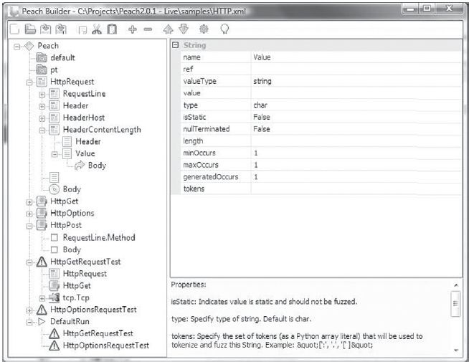
Fuzzing a protocol
Peach is a Smart Fuzzer that is capable of generating a protocol from scratch or mutating an existing protocol.
Introduction to Software Testing (Ch 4)
© Ammann & Offutt

Slide 14
Fuzzing a file
Example: A Sample PNG file spec.
//png.spk
//author: Charlie Miller
// Header - fixed.
s_binary("89504E470D0A1A0A");
// IHDRChunk
s_binary_block_size_word_bigendian("IHDR"); //size of data field
s_block_start("IHDRcrc");
s_string("IHDR"); // type
s_block_start("IHDR");
// The following becomes s_int_variable for variable stuff
// 1=BINARYBIGENDIAN, 3=ONEBYE
s_push_int(0x1a, 1); // Width
s_push_int(0x14, 1); // Height
s_push_int(0x8, 3); // Bit Depth - should be 1,2,4,8,16, based on colortype
s_push_int(0x3, 3); // ColorType - should be 0,2,3,4,6
s_binary("00 00"); // Compression || Filter - shall be 00 00
s_push_int(0x0, 3); // Interlace - should be 0,1
s_block_end("IHDR");
s_binary_block_crc_word_littleendian("IHDRcrc"); // crc of type and data
s_block_end("IHDRcrc");
...
Introduction to Software Testing (Ch 4)
© Ammann & Offutt

Slide 15
Fuzzing emails
Simple examples on SMTP
mail from: sender@testhost
  This would then be sent in the following forms to see what effect they have:
mailmailmailmail from: sender@testhost
mail fromfromfromfrom: sender@testhost
mail from:::: sender@testhost
mail from: sendersendersendersender@testhost
mail from: sender@@@@testhost
mail from: sender@testhosttesthosttesthosttesthost
Introduction to Software Testing (Ch 4)
© Ammann & Offutt

Slide 16
Fuzzing Apps
Example: fuzzing a pdf viewer
Google for .pdf (about 1 billion results)
Crawl pages to build a corpus
Use fuzzing tool (or script to)
  Grab a file
  Mutate that file
  Feed it to the program
  Record if it crashed (and input that crashed it)
Introduction to Software Testing (Ch 4)
© Ammann & Offutt

Slide 17
Fuzzer Classes
Black‐box fuzzing
  Treating the system as a blackbox during fuzzing.
  not knowing details of the implementation
Grey‐box fuzzing
  Instrumentation to SuT allowed.
White‐box fuzzing
  Design fuzzing based on internals of the SuT
Introduction to Software Testing (Ch 4)
© Ammann & Offutt

Slide 18
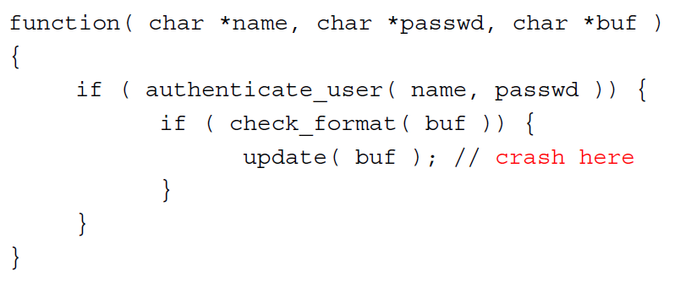
Fuzzing: Black-Box
original idea of Professor Miller 1988
Pros: Easy to configure
Cons: May not search efficiently
  May re‐run the same path over again (low coverage)
  May be very hard to generate inputs for certain paths (checksums, hashes, restrictive conditions)
  May cause the program to terminate for logical reasons
    Example: fail format checks and stop
Introduction to Software Testing (Ch 4)
© Ammann & Offutt

Slide 19
Fuzzing: Black-Box
Mutation‐Based Fuzzing, more in Chapter 5
User supplies a well-formed input
Fuzzing: Generate random changes to that input
No assumptions about input
Only assumes that variants of well-formed input may be problematic
Tools: Taof, GPF, ProxyFuzz, FileFuzz, Filep, etc.
Example: zzuf - http://sam.zoy.org/zzuf/
zzuf ‐s 0:1000000 ‐c ‐C 0 ‐q ‐T 3 objdump ‐x win9x.exe
Fuzzes the program objdump using the sample input win9x.exe
Try 1M seed values (-s) from command line (-c) and keep running if crashed (-C 0) with timeout (-T 3)
Introduction to Software Testing (Ch 4)
© Ammann & Offutt

Slide 20
Fuzzing: Black-Box
Mutation‐Based Fuzzing
Pros:
  Easy to setup, and not dependent on program details
    But may be strongly biased by the initial input
Cons:
  May re‐run the same path over again (same test)
  May be very hard to generate inputs for certain paths (checksums, hashes, restrictive conditions)
Introduction to Software Testing (Ch 4)
© Ammann & Offutt

Slide 21
Fuzzing: Black-Box
Generation‐Based Fuzzing
Generational fuzzer generates inputs “from scratch” rather than using an initial input and mutating
However, require the user to specify a format or protocol spec to start
Equivalently, write a generator for generating well-formatted input
Examples include: SPIKE, Peach Fuzz
However format‐aware fuzzing is cumbersome, because you'll need a fuzzer specification for every input format you are fuzzing
Introduction to Software Testing (Ch 4)
© Ammann & Offutt

Slide 22
Fuzzing: Black-Box
Generation‐Based Fuzzing
Can be more accurate, but at a cost
Pros: More complete search
  Values more specific to the program operation
  Can account for dependencies between inputs
Cons: More work
  Get the specification
  Write the generator – ad hoc
  Need to do for each program
Introduction to Software Testing (Ch 4)
© Ammann & Offutt

Slide 23
Fuzzing: Grey-Box
Finds flaws, but still does not understand the program
Pros: Much better than black box testing
  Essentially no configuration
  Lots of crashes have been identified
Cons: Still a bit of a stab in the dark
  May not be able to execute some paths
  Searches for inputs independently from the program
  Need to improve the effectiveness further
Introduction to Software Testing (Ch 4)
© Ammann & Offutt

Slide 24
Fuzzing: Grey-Box
Coverage‐Based Fuzzing
Rather than treating the program as a black box, instrument the program to track coverage
  E.g., the edges covered
Maintain a pool of high‐quality tests
Start with some initial ones specified by users
Mutate tests in the pool to generate new tests
Run new tests
If a new test leads to new coverage (e.g., edges),
  save the new test to the pool;
  otherwise, discard the new test
Introduction to Software Testing (Ch 4)
© Ammann & Offutt

Slide 25
Fuzzing: Grey-Box
Coverage‐Based Fuzzing
Special type of mutation-based fuzzing
Run mutated inputs on instrumented program and measure code coverage
  Examples: AFL, libfuzzer
Search for mutants that result in coverage increase
Often use genetic algorithms, i.e., try random mutations on test corpus and only add mutants to the corpus if coverage increases
Introduction to Software Testing (Ch 4)
© Ammann & Offutt

Slide 26
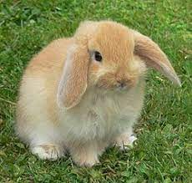
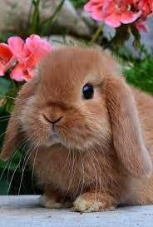
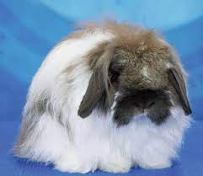
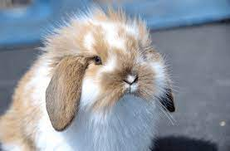
Fuzzing: Grey-Box/Coverage-Based
Coverage‐Based Fuzzing, example tool
American Fuzzy Lop (AFL)
“State of the practice” at this time
American Fuzzy Lop Rabbit ?
Introduction to Software Testing (Ch 4)
© Ammann & Offutt

Slide 27
Fuzzing: Grey-Box/Coverage-Based
American Fuzzy Lop (AFL), Build
Provides compiler wrappers for gcc to instrument target program to track test coverage
Replace the gcc compiler in your build process with afl‐gcc
For example, in the Makefile
CC=path-to/afl-gcc
Then build your target program with afl‐gcc
Generate a binary instrumented for AFL fuzzing
Introduction to Software Testing (Ch 4)
© Ammann & Offutt

Slide 28
Fuzzing: Grey-Box/Coverage-Based
American Fuzzy Lop (AFL), Setting up
Compiling through AFL
  Basically, replace gcc by afl‐gcc
  path‐to‐afl/afl‐gcc test.c ‐o test
Fuzzing through AFL
  path‐to‐afl/afl‐fuzz ‐i testcase ‐o output ./test @@
  Assuming test cases are under testcase, the output goes to the output dir
  @@ tells AFL to take the file names under testcase and feed it to test
Introduction to Software Testing (Ch 4)
© Ammann & Offutt

Slide 29
Fuzzing: Grey-Box/Coverage-Based
American Fuzzy Lop (AFL), Setting up the environment
After you install AFL but before you can use it effectively, you must set the following environment variables
E.g., On CentOS
  export AFL_I_DONT_CARE_ABOUT_MISSING_CRASHES=1
  export AFL_SKIP_CPUFREQ=1
The former speeds up response from crashes
The latter suppresses AFL complaint about missing some short‐lived processes
Introduction to Software Testing (Ch 4)
© Ammann & Offutt

Slide 30
Fuzzing: Grey-Box/Coverage-Based
AFL, configuration
Instrument the binary at compile-time
Regular mode: instrument assembly
Recent addition: LLVM compiler instrumentation mode
Provide 64K counters representing all edges in the app
Hashtable keeps track of # of execution of edges
  8 bits per edge (# of executions: 1, 2, 3, 4-7, 8-15, 16-31, 32-127, 128+)
  Imprecise (edges may collide) but very efficient
AFL-fuzz is the driver process, the target app runs as separate process(es)
Introduction to Software Testing (Ch 4)
© Ammann & Offutt

Slide 31
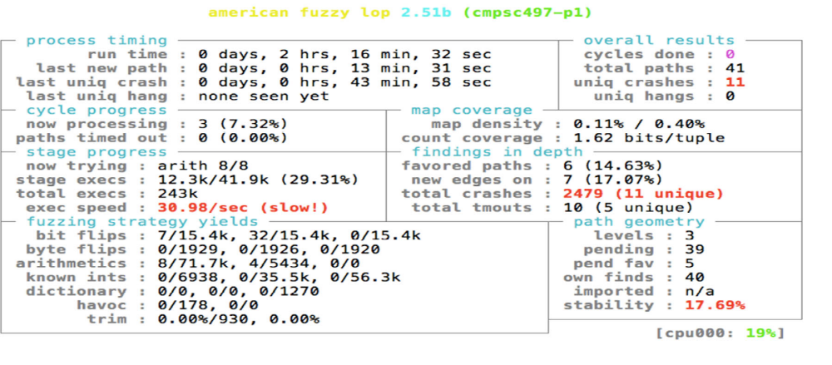
Fuzzing: Grey-Box/Coverage-Based
AFL Display
Tracks the execution of the fuzzer
Key information are
  “total paths” – number of different execution paths tried
  “unique crashes” – number of unique crash locations
Introduction to Software Testing (Ch 4)
© Ammann & Offutt

Slide 32
Fuzzing: Grey-Box/Coverage-Based
AFL Output
Shows the results of the fuzzer
  E.g., provides inputs that will cause the crash
File “fuzzer_stats” provides summary of stats – UI
File “plot_data” shows the progress of fuzzer
Directory “queue” shows inputs that led to paths
Directory “crashes” contains input that caused crash
Directory “hangs” contains input that caused hang
AFL Crashes
May be caused by failed assertions – as they abort
Had several assertions caught as crashes, but format violated my checks
Introduction to Software Testing (Ch 4)
© Ammann & Offutt

Slide 33
Fuzzing: Grey-Box/Coverage-Based
AFL Operation
How does AFL work?
http://lcamtuf.coredump.cx/afl/technical_details.txt
Mutation strategies
  Highly deterministic at first – bit flips, add/sub integer values, and choose interesting integer values
  Then, non‐deterministic choices – insertions, deletions, and combinations of test cases
Introduction to Software Testing (Ch 4)
© Ammann & Offutt

Slide 34
Fuzzing: Grey-Box/Coverage-Based
Finds flaws, but still does not understand the program
Pros: Much better than black box testing
  Essentially no configuration
  Lots of crashes have been identified
Cons: Still a bit of a stab in the dark
  May not be able to execute some paths
  Searches for inputs independently from the program
Need to improve the effectiveness further
Introduction to Software Testing (Ch 4)
© Ammann & Offutt

Slide 35
Fuzzing: Grey-Box
Dataflow-guided fuzzing
Intercept the data flow, analyze the inputs of comparisons
Incurs extra overhead
Modify the test inputs, observe the effect on comparisons
Prototype implementations in libFuzzer and go-fuzz
Introduction to Software Testing (Ch 4)
© Ammann & Offutt

Slide 36
Fuzzing: White-Box
Combines test generation with fuzzing
  Test generation based on static analysis and/or symbolic execution
  Rather than generating new inputs and hoping that they enable a new path to be executed, compute inputs that will execute a desired path
    And use them as fuzzing inputs
Goal:
  Given a sequential program with a set of input parameters, generate a set of inputs that maximizes code coverage
Introduction to Software Testing (Ch 4)
© Ammann & Offutt

Slide 37
Fuzzing Tools
Input Generation
Existing generational fuzzers for common protocols (ftp, http, SNMP, etc.)
  Mu-4000, Codenomicon, PROTOS, FTPFuzz
Fuzzing Frameworks: You provide a spec, they provide a fuzz set
  SPIKE, Peach, Sulley
Dumb Fuzzing automated: you provide the files or packet traces, they provide the fuzz sets
  Filep, Taof, GPF, ProxyFuzz, PeachShark
Many special purpose fuzzers already exist as well
  ActiveX (AxMan), regular expressions, etc.
Introduction to Software Testing (Ch 4)
© Ammann & Offutt

Slide 38
Fuzzing Tools
Input Inject
Simplest
  Run program on fuzzed file
  Replay fuzzed packet trace
  ZZUF, Taof, GPF, ProxyFuzz, FileFuzz, Filep, etc
Modify existing program/client
  Invoke fuzzer at appropriate point
Use fuzzing framework
  e.g. Peach automates generating COM interface fuzzers
Introduction to Software Testing (Ch 4)
© Ammann & Offutt

Slide 39
Fuzzing Tools
Test Oracle – failure detection
See if program crashed
  Type of crash can tell a lot (SEGV vs. assert fail)
Run program under dynamic memory error detector (valgrind/purify/AddressSanitizer)
  Catch more bugs, but more expensive per run.
See if program locks up
Roll your own checker e.g. valgrind skins
Introduction to Software Testing (Ch 4)
© Ammann & Offutt

Slide 40
Fuzzing Tools
Workflow Automation
Sulley, Peach, Mu-4000 all provide tools to aid setup, running, recording, etc.
Virtual machines can help create reproducable workload
Some assembly still required
Introduction to Software Testing (Ch 4)
© Ammann & Offutt

Slide 41
Introduction to Software Testing (Ch 4)
© Ammann & Offutt

